Slide 1
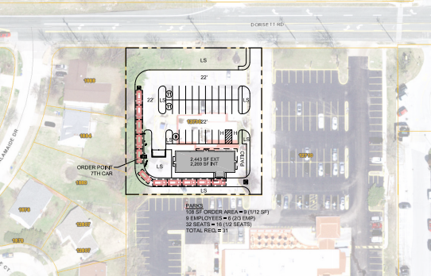
12730 Dorsett Rd Maryland Heights, MO
12730 Dorsett Rd Maryland Heights, MO 63043
New Development!
• Building SF: 2,443
• Maryland Heights Location
• Excellent Visibility
New development coming to high traffic intersection of Dorsett and McKelvey.
Adam Hartig
Adam@clay-adams.com
573-355-0827
Alex Zoellner
alex@clay-adams.com
314-269-6225

Slide 2
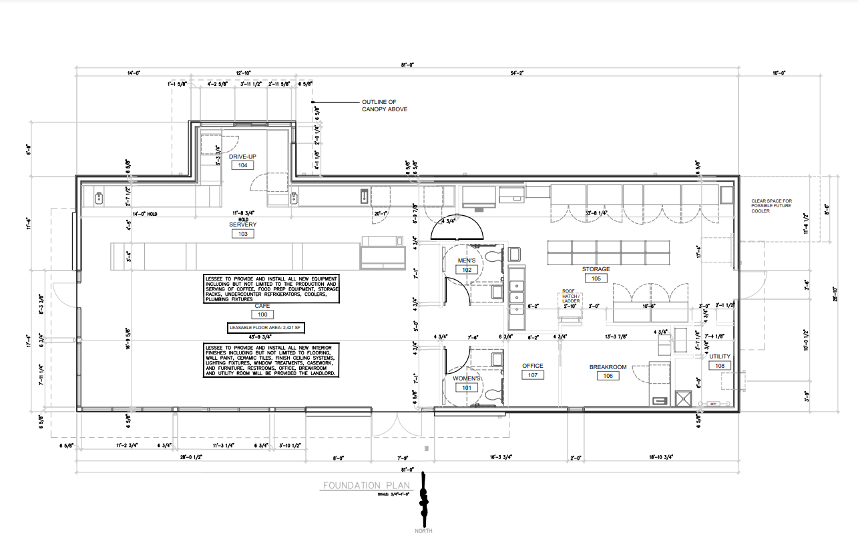
Adam Hartig
Adam@clay-adams.com
573-355-0827
Alex Zoellner
alex@clay-adams.com
314-269-6225

